Slide 1
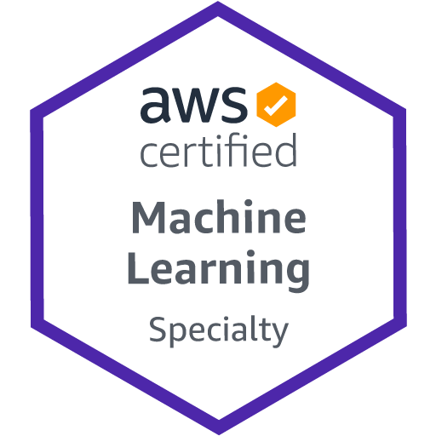
AWS Machine Learning Specialty Course Notes
Data Engineering
Section Summary
Date: 19/12/21
Amazon Services
Kinesis
Kinesis Data Streams is a fully managed AWS service that you can use to collect and process large streams of data records in real time.
Kinesis Data Firehose is an extract, transform, and load (ETL) service that captures, transforms, and delivers streaming data to data lakes, data stores, and analytics services. This could be read directly from producers themselves or from Kinesis data streams and be read to a datastore such as S3, ElasticSearch, Redshift (through S3) or Splunk (3rd party). This is done ‘near real time’ and any transformations are done using AWS Lambda.
Kinesis Data Analytics allows users to perform real time analytics on a Kinesis Data Stream using SQL or Apache Flink. Can also perform transformations through invoking Lambda functions to pre-process the records.
Kinesis Video Data Streams functions similarly to Data Streams but for video data.
Glue
Glue data crawler can create a glue data catalogue (metadata repository) containing the schema information.
Glue is also an ETL service allowing for various data transforms in a serverless environment using scala or python based code.
Not mentioned in these slides but data analysts and data scientists can use AWS Glue DataBrew to visually enrich, clean, and normalize data without writing code.
Athena
Athena is an interactive query service that makes it easy to analyze data in Amazon S3 using standard SQL.
SQL commands through Athena on data stored in S3, we first need to generate our Glue data catalogue using the crawlers
Additional Services
AWS Data Pipeline: ETL orchestration service, actual ETL happens within an EC2 instance.
AWS Batch: Run batch processes on an S3 bucket using a docker image.
AWS DMS (Data Migration Service): Not an ETL service, can only move data from one location to another.
AWS Step Functions: Orchestration service allowing users to piece together functions from different services, like a windows .bat file.

Slide 2
AWS Machine Learning Specialty Course Notes
Data Engineering
Section Summary
Date: 19/12/21
Amazon Storage & Databases
S3
Any object/data type stored in buckets and partitions.
Can apply lifecycle rules to move our data to the correct storage tier (or delete) for our needs.
IAM policies control what services and users have access to the data in each bucket and partition.
Bucket policies govern rules for all on a given bucket.
Added security with SSE (Server-Side Encryption) and SSE-KMS (SSE Key Management System).
Redshift
Data warehouse where we can bring together datasets from across organisation so it can be easily queried (SQL based).
Needs provisioning in advance although they do now provide a serverless option.
Redshift spectrum allows us to query data directly in S3 (like Athena but we use provisioned resource with redshift).
RDS
Similar to Redshift, it is a datastore. But unlike Redshift that’s suitable for large queries, analytics, BI etc. where as RDS is suitable for smaller queries that take place at a frequent basis.
Additional Stores
DynamoDB: NoSQL data store – means not only SQL.
ElasticSearch: Useful for indexing of data
ElastiCache: Caching mechanism.

Slide 3
AWS Machine Learning Specialty Course Notes
Data Engineering
Section: 2.5
Date: 05/12/21
Amazon S3 (Amazon Simple Storage Service
Amazon S3 provides object storage (of any data type) through a web service interface.
It allows you to store objects (files) in buckets (directories). The relative path to the object from the bucket acts as the key.
<my_bucket>/folder1/folder2/file.txt - Note this is not actually a set of folders its just a long key name.
This is the backbone for many AWS services (including SageMaker). Its where all the data (we create a ‘data lake’) and is completely decoupled from compute.
S3 Data Partitioning
Speeds up queries.
S3://bucket/my-data-set/year/month/day/data.csv - The year, month and day are examples of data partitions.
S3://bucket/my-data-set/product-id/data.csv - Here we use product ID as the data partition.
We can define whatever data partitioning strategy is relevant for our problem.
S3 data partitioning is done using tools like AWS Glue.
How much do I owe: https://console.aws.amazon.com/billing/home#/

Slide 4
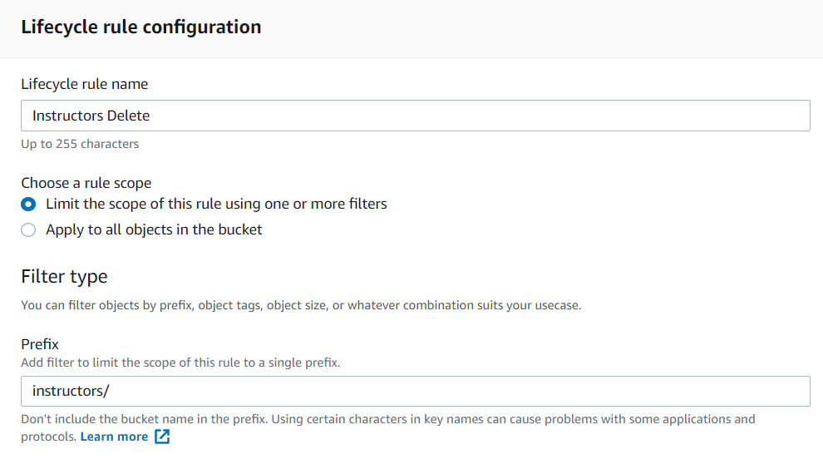
AWS Machine Learning Specialty Course Notes
Data Engineering
Section: 2.6
Date: 06/12/21
S3 Storage Tiers
There are different tiers in S3 that come with different pricing depending on how frequently you need to access the data and how many data centres you want it stored it (more places you store it the less likely amazon are to lose it).
Standard (frequently accessed, AZ(Availability Zones)>2).
Standard infrequent access (infrequent access, AZ>2)
One zone infrequent access (infrequent access, AZ=1)
Glacier (used for archives)
Intelligent (amazon will decide which tier is best.
S3 Lifecycle Rules
You can enter actions under lifecycle rules that will perform a task automatically throughout the lifecycle of the data.
Transition actions – allows you to move from one class to another.
Expiration actions – allows you to delete data.

Slide 5
AWS Machine Learning Specialty Course Notes
Data Engineering
Section: 2.7
Date: 06/12/21
S3 Security – Encryption
4 different types of encryption we can use:
SSE (Server Side Encryption) which uses keys handled by AWS.
- Object is sent to S3, an AWS key is used for encryption and then the data is stored.
SSE-KMS (SSE-Key Management Service) – similar to standard AWS SSE but allows us control over the keys using the key management service. If you store it in KMS, you don't need to include it in the requests to S3. Instead, just upload/download your files normally and KMS will talk to S3 and handle that for you.
- In KMS an object is send to S3, combined with an AWS key and a Customer Master Key (CMK) encryption and then the data is stored.
SSE-C (Customer) - If you want to manage the encryption key yourself, you need to include that encryption key as part of every request to S3. If you lose the encryption key, you lose all the objects that are encrypted by this key.
Client Side Encryption – Data is encrypted outside of AWS before sending it to S3.
For ML purposes only SSE and SSE-KMS are really used.

Slide 6
AWS Machine Learning Specialty Course Notes
Data Engineering
Section: 2.7
Date: 06/12/21
S3 Security – Access
User Based
IAM (Identity Access Management) Policies. We have control over what API calls a user or process (for example a Glue data crawler) is allowed to do on our bucket.
- Any actions that you don't explicitly allow are denied.
- Users cannot access any resources that you do not explicitly grant permissions to.
- https://aws.amazon.com/iam/features/manage-permissions/
Resource Based
Bucket Policies – bucket wide rules from the S3 console that can be set to specific users. Use S3 bucket for policy to:
- Grant public access to the bucket
- Force objects to be encrypted at upload (previously a bucket policy was needed for this, now it can be done straight from the properties tab of a bucket)
- Grant access to another account (Cross Account)
Object ACL (Access Control List) – Finer grained and specifies which users have access to what.
Bucket ACL – Less common, same as above but higher level for each bucket.
Exam is important to understand User IAM and Bucket policies.

Slide 7
AWS Machine Learning Specialty Course Notes
Data Engineering
Section: 2.7
Date: 06/12/21
S3 Security – Other
Networking VPC (Virtual Private Cloud) Endpoint Gateway:
- VPC It is a cloud computing service that provides users a virtual private cloud, by "provisioning a logically isolated section of Amazon Web Services Cloud“
- VPC Endpoint Gateway allow traffic to stay within your VPC (instead of going through public web).
- Make sure your private services (AWS SageMaker ) can access S3.
- Very important for AWS ML Exam
Logging and Audit
- Can store logs of who accessed your bucket directly in S3.
- API calls can be logged in AWS CloudTrail
Tag based
- You can add tags e.g. classification=PHI (public health information). No info on how this may be useful, hopefully it will become clearer later.

Slide 8
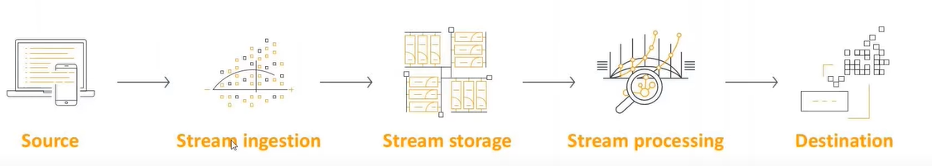
AWS Machine Learning Specialty Course Notes
Data Engineering
Section: 2.8 2.9
Date: 07/12/21
AWS Kinesis
Kinesis is split into 4 services that all run on real time or near real time data. This real time data could be website clicks, live football stats, video etc. (effectively anything that may be feeding/producing data to you, the consumer).
Kinesis Streams – allows you to ingest data at low latency (~200ms classic, ~70ms for enhanced).
Kinesis Analytics – perform real time analytics using SQL.
Kinesis Firehose – allows you to write data ‘near real time’ (down to every second) to storage in S3, Redshift and Splunk.
Kinesis Video Streams – allows you to ingest video data.
Source is where the data is being generated (say peoples smart phones if its click data). The data is ingested into the stream storage (in this case this is Kinesis streams). We can then apply some transforms or processing using AWS Lambda for example. Then the data is sent to its destination using Kinesis firehose.

Slide 9
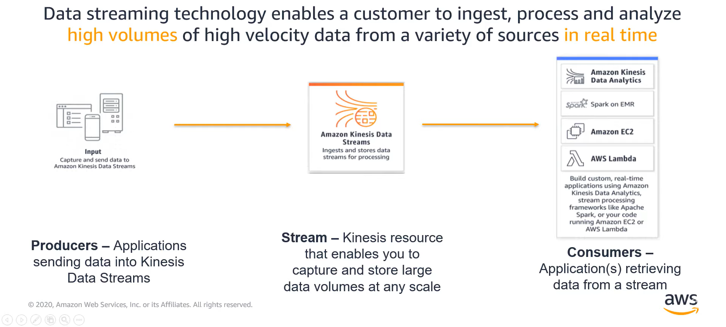
AWS Machine Learning Specialty Course Notes
Data Engineering
Section: 2.8 2.9
Date: 07/12/21
In this pipeline example below we are not sending our data to permantent storage using kinesis firehose. Instead our direct producer of the data is Kinesis data analytics, AWS lambda, AWS EC2 (Elastic compute cloud – basically a virtual computer)

Slide 10
AWS Machine Learning Specialty Course Notes
Data Engineering
Section: 2.8 2.9
Date: 07/12/21
Kinesis Streams (temporary storage of live data)
Streams are partitioned into shards. Each shard can ingest up to 1mb/s of data and store that data for a default of 24hours (can be increased to 365 days). If you attempt to ingest more you will get a ‘ProvisionedThroughputException’.
We can therefore do our on the fly analytics using Kinesis analytics, or we must send our live data to permanent storage for example into S3, before the data is removed from the shard. If we are only interested in showing live data on our applications however, we may not need to send this data to storage.
On the consumer side, you can read 2mb/s or make a max of 5 API calls/s per shard.
Kinesis data streams only scales if you add additional shards, it does not scale automatically.
Main use case for kinesis streams is in building live applications.
Key concepts:
Data record – A unit of data that is stored by Kinesis Data Streams.
Data stream – A resource that represents a group of data records.
Shard – A uniquely identified sequence of data records in a stream. A data stream is composed of one or more shards. Each shard provides a fixed unit of capacity.
Producer – A source that puts data into a Kinesis data stream.
Consumer – An application that gets records from data streams and processes them.
Kinesis Producer Library (KPL) – An easy-to-use, highly configurable library that helps you write to a data stream.
Kinesis Client Library (KCL) – An easy-to-use, highly configurable library that helps you consume and process data from a data stream.
Data Stream
Shard
Data record
Shard
Shard

Slide 11
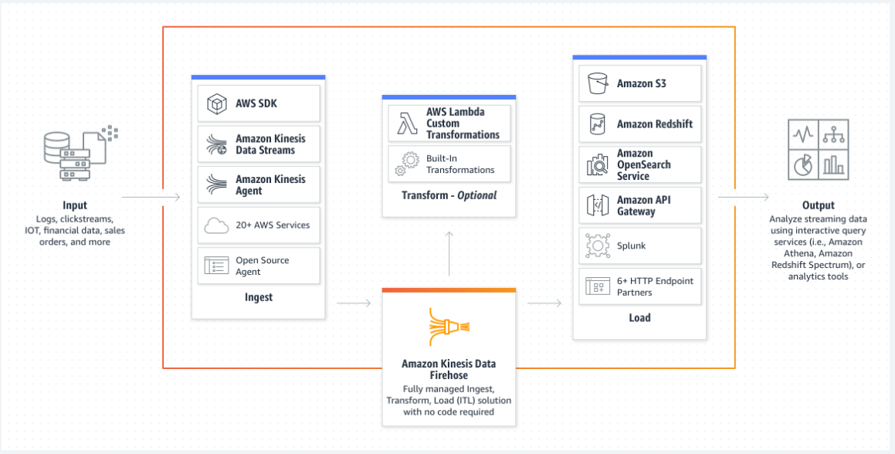
AWS Machine Learning Specialty Course Notes
Data Engineering
Section: 2.8 2.9
Date: 07/12/21
Kinesis Firehose (delivery of ‘near live’ data)
Kinesis firehose can ingest data directly from the producers themselves, or from kinesis streams.
Firehose will read the data in <1mb chunks (if from kinesis streams), and write these to the target area(s) in batches.
These target areas include Amazon S3, Amazon Redshift (which is a copy through S3), Amazon ElasticSearch, third party destination such as splunk, or a custom non AWS destination with a HTTP endpoint.
Batches are written to the destination at a minimum of 60seconds; so it is classed ‘near real-time’.
There is automatic scaling, no need for pre-defined shards – you only pay for the amount of data going through firehose.
Supports data transformations using AWS Lambda and compression into zip files for example.

Slide 12
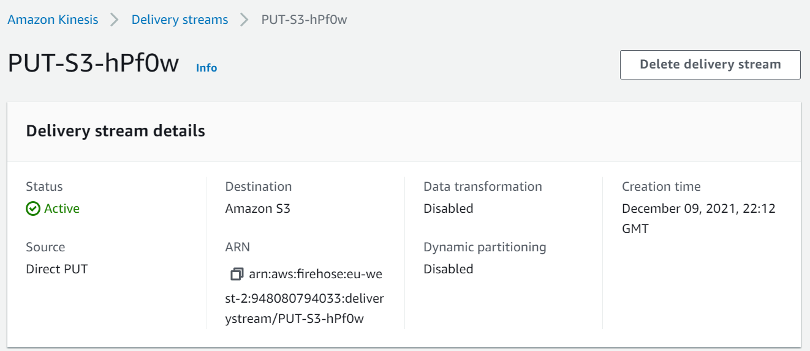
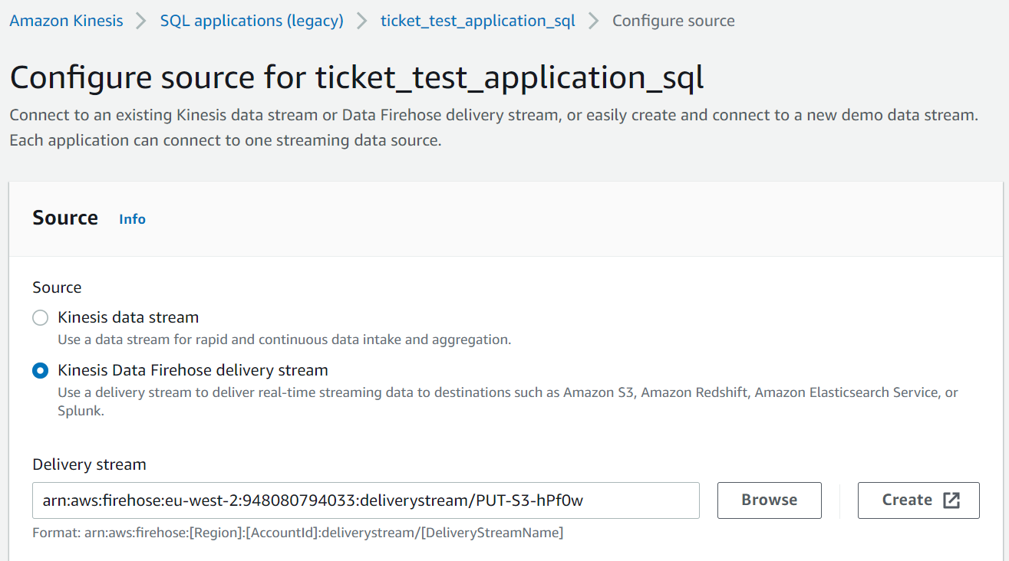
AWS Machine Learning Specialty Course Notes
Data Engineering
Section: 2.10 2.11
Date: 08/12/21
Kinesis Data Analytics
Data analytics can actually take data directly from Kinesis firehose as well as Kinesis streams.
We can also combine the input streams above, with reference tables from an S3 bucket. For example, using an SQL command we could perform a lookup with the S3 bucket reference table and convert our input stream data into another form.
Or we can reduce the size of our dataset by performing simple transformations, often referred to as ETL (extract, transform, load) through invoking Lambda functions to pre-process the records.
An example use case of the above is we could have continuous metric generation for say a leader board on a game. Or we could have responsive analytics where we’re looking for a certain criteria before being alerted.
We can use SQL or Flink to write the above, or Lambda for pre-processing.
Pay for resource consumed and it is serverless (https://aws.amazon.com/lambda/serverless-architectures-learn-more/). This is still run on amazon servers, it just means server management is done by AWS. It is costly though.
IAM permissions need to be granted to access the streaming source and destinations.
Kinesis firehose demo setup which is sending chunked JSON files into my S3 bucket every 60 seconds
Kinesis analytics setup to receive data directly from my kinesis firehose setup previously

Slide 13
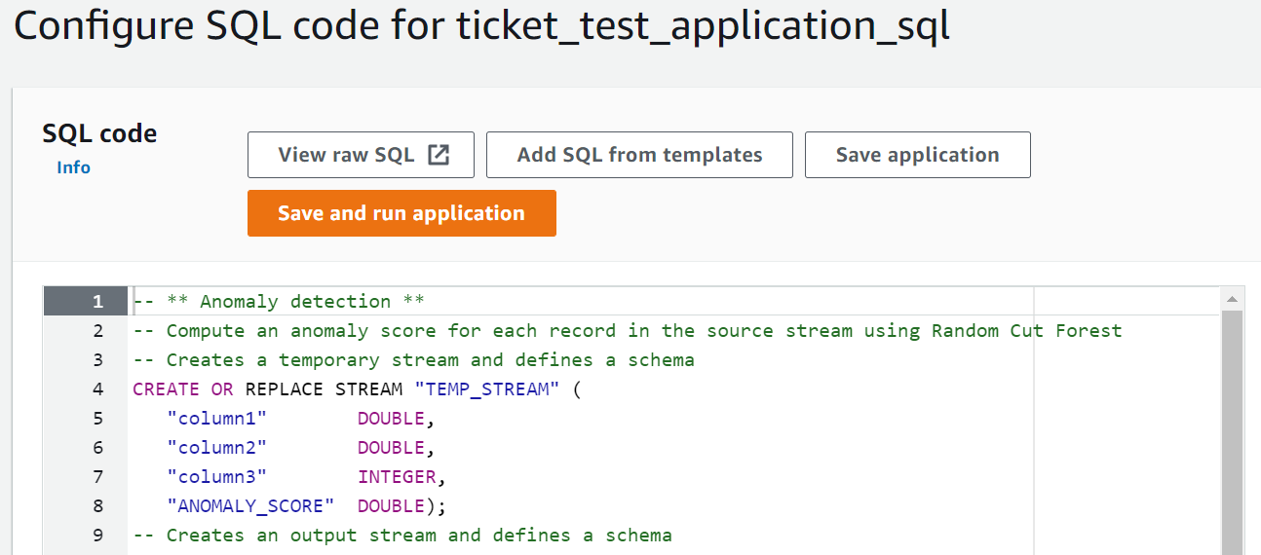
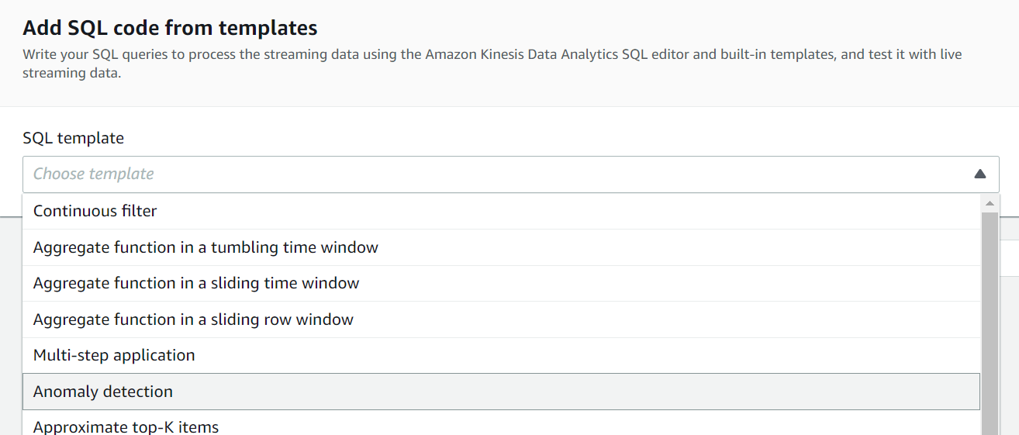
AWS Machine Learning Specialty Course Notes
Data Engineering
Section: 2.10 2.11
Date: 08/12/21
Machine Learning on Kinesis Data Streams
There are two main SQL functions we can run on our data in analytics:
RANDOM_CUT_FOREST – Unsupervised model trained on recent data from streams or firehose to detect anomalies. This model is ever updating based on recently streamed data. An ‘anomaly score’ is given to each data point depending on how far away it is from an identified cluster. Scores beyond 3 standard deviations from the mean ‘anomaly score’ are often considered anomalous. https://docs.aws.amazon.com/quicksight/latest/user/what-is-random-cut-forest.html - https://docs.aws.amazon.com/sagemaker/latest/dg/randomcutforest.html
HOTSPOTS – find dense areas in your data, useful for drawing quick inferences from your data, silly example: all red cars seem to travel at 65mph. https://docs.aws.amazon.com/kinesisanalytics/latest/sqlref/sqlrf-hotspots.html

Slide 14
AWS Machine Learning Specialty Course Notes
Data Engineering
Section: 2.12 2.13
Date: 09/12/21
Kinesis Video Streams
This is very similar to kinesis streams but for video instead. There are a few differenced highlighted below:
Data can be stored from 1 hour to 10 years. This window is larger than data streams (1 day to 1 year).
Producers into Kinesis video streams includes lots of different sources such as smartphones or webcams. List of compatible devices can be found in the following: https://docs.aws.amazon.com/kinesisvideostreams/latest/dg/system-requirements.html
Just like data streams the consumers can be an EC2 instance, SageMaker etc.
One complex example is shown where data goes into video streams, inferences are made using Fargate (docker) and these inferences are sent to Kinesis data streams before going to AWS lambda.
Kinesis Summary
Kinesis data streams: we’ll need to use this if we want to make real-time machine learning applications
Kinesis data firehose: we’ll need this if we want to ingest very large mounts of data near-real time into storage.
Kinesis data analytics: we’ll need this if we want to perform real time basic analysis including using ML.
Kinesis video streams: we’ll need this is we want to build real-time ML models and applications with live video streams.

Slide 15
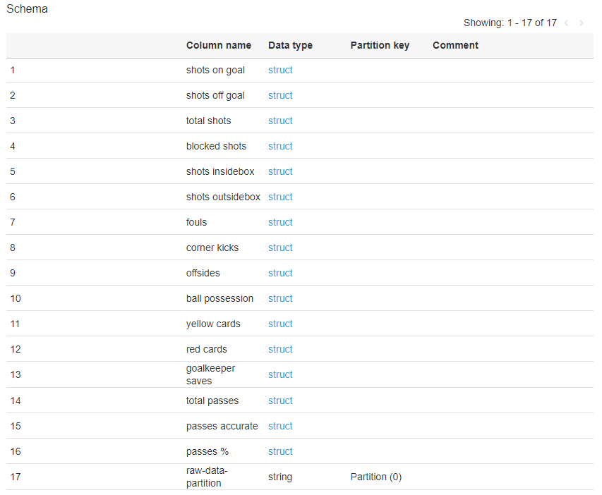
AWS Machine Learning Specialty Course Notes
Data Engineering
Section: 2.14 2.15
Date: 11/12/21
AWS Glue Basics
Glue is an Extract, Transform and Load service (ETL). It allows you to organise, locate, move and transform datasets prior to being applied for use, for example in training a machine learning model. It can therefore form an important stage or data cleaning and preparation needed prior to training ML models.
The glue data catalogue is a metadata repository (meaning a set of data that describes and gives information about other data).
A Glue crawler can be used to go through an S3 bucket, AWS Redshift or AWS RDS and infer ‘schemas’ and partitions.
It works on structured data types such as JSON, Parquet, CSV etc.
An example of an extracted schema can be seen after a crawler has been run over my football project data containing JSON files. It has identified the contents of the files. (https://docs.aws.amazon.com/clouddirectory/latest/developerguide/schemas.html)
When a schema has been applied to a directory, all data within that directory must then conform to that applied schema.

Slide 16
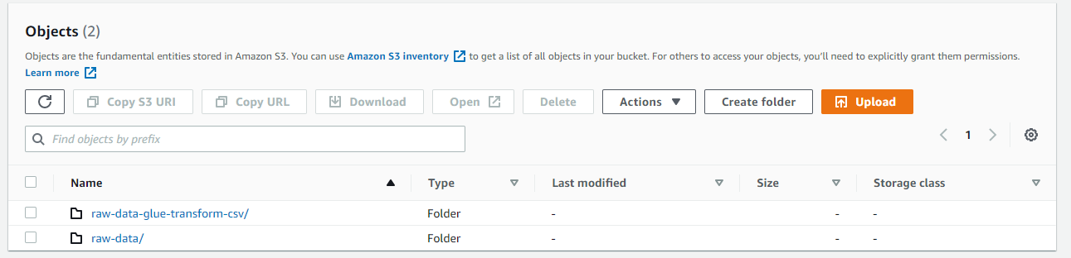
AWS Machine Learning Specialty Course Notes
Data Engineering
Section: 2.16 2.17
Date: 11/12/21
AWS Glue ETL
As mentioned previously Glue allows users to Extract, Transform and Load (ETL). The jobs are run on a serverless Spark platform meaning no provisioning of resource is needed prior to running jobs, you simply pay for the resource consumed.
Using Glue ETL we can apply some of the following transforms:
DropFields & DropNullFields - remove (null) fields
Filter - specify a function to filter records
Join - joins two dynamic frames.
Map - add fields, delete fields, perform external lookups
FindMatches ML – identify duplicate or matching samples/objects even if all fields do not perfectly match. This could be useful to prevent inadvertent oversampling (e.g. customers that have accidently signed up more than once).
Format conversions – for example CSV to JSON, Avro, Parquet, XML etc.
Example below showing conversion of raw json data in my football prediction bucking into csv format.
https://aws.amazon.com/glue/?whats-new-cards.sort-by=item.additionalFields.postDateTime&whats-new-cards.sort-order=desc

Slide 17
AWS Machine Learning Specialty Course Notes
Data Engineering
Section: 2.18
Date: 17/12/21
AWS Athena
AWS Athena is a serverless interactive query tool.
Serverless – no need to instantiate clusters or any infrastructure, no admin needed and auto-performant – it will scale to your needs.
Interactive – Different query engines have different behaviours (e.g. Apache hive is not interactive, has high throughput).
Query tool – Not an ETL tool, instead it can be used ‘seamlessly’ with SQL to conduct analysis of data stored in amazon S3.
Important to note is that in order to run SQL commands through Athena on data stored in S3, we first need to generate our Glue data catalogue using the crawlers. This allows Athena to understand what the schema of these tables is.

Slide 18
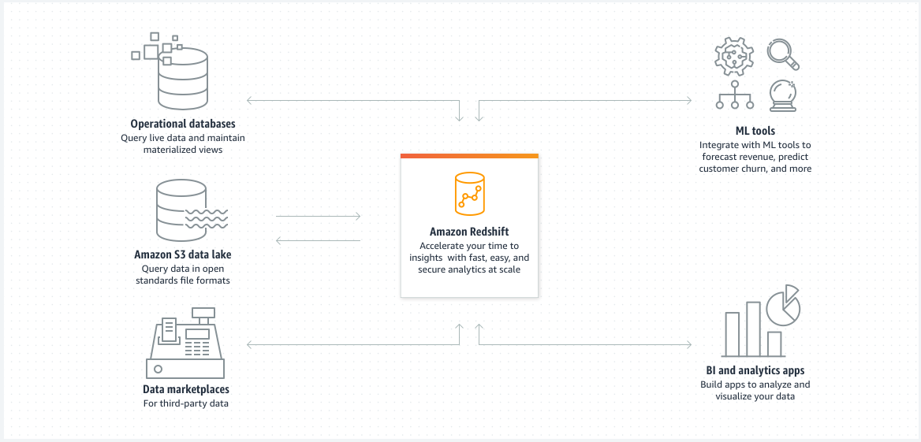
AWS Machine Learning Specialty Course Notes
Data Engineering
Section: 2.19 2.20
Date: 17/12/21
AWS Redshift
Data warehouse – bring together datasets from all across organisation so it can be easily queried (SQL based).
Parameter groups – if you have lots of users all using redshift cluster, you can specify which groups or teams have higher priority.
Optimised for large queries (OLAP – Online Analytical Processing).
Not serverless – needs provisioning in advance, although they do now provide a serverless option.
Data can be loaded from S3 into Redshift or we can use Redshift Spectrum to query data directly in S3 (similar to Athena).
Difference between Redshift spectrum and Athena is performance. Spectrum and Athena differ in that Athena relies on pooled resources provided by AWS to return query results, whereas Spectrum resources are allocated according to your Redshift cluster size.

Slide 19
AWS Machine Learning Specialty Course Notes
Data Engineering
Section: 2.20
Date: 17/12/21
AWS RDS
Similar to Redshift in that it is also a relational store for SQL queries.
Also must provision servers in advance.
RDS is more suited for smaller queries that happen at a more frequent basis.
AWS DynamoDB
NoSQL data store – means not only SQL.
For example it I useful to store a ML model served by your application.
AWS S3
Already seen this in detail, provides object storage.
Serverless with no limit on storage.
Can integrate with most AWS services.
AWS ElasticSearch
Useful for indexing of data
AWS ElastiCache
Caching mechanism.

Slide 20
AWS Machine Learning Specialty Course Notes
Data Engineering
Section: 2.21 2.22 2.23
Date: 18/12/21
AWS Data Pipeline
Allows you to move data from one destination to another. For example this could be from DynamoDB to S3. We may need to do this so we can run SageMaker on S3 data.
The moving is actually done on an EC2 instance that is managed by AWS Data Pipeline.
The user has control over the resources as they need to setup the EC2 instance. They also have more control over the ETL code which takes place on the EC2 instance.
Differs from AWS Glue as we do not need to configure or manage the resources using Glue.
AWS Batch
Allows you to run any batch process that can be defined by a docker image.
This could be cleaning data in an S3 bucket.
Dynamic provisioning of an EC2 instance(s), you just pay for the underlying EC2 instances.
For non ETL, or processes that are just run on data and we don’t want to move data from one store to another, AWS batch is probably best.
AWS DMS (Data Migration Service).
Not an ETL service as it will not transform data, it simply moves data from one location to another.
Common to use DMS to move data from on premise to in the cloud, and then use Glue to perform an ETL on it.

Slide 21
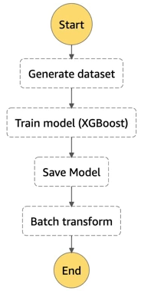
AWS Machine Learning Specialty Course Notes
Data Engineering
Section: 2.24
Date: 18/12/21
AWS Step Functions
Allows you to piece together various different functions that use different services.
For example on the right, we may generate a training dataset using lambda functions, we then may train our model using SageMaker, and then save the model into an S3 bucket and then maybe we perform some ETL using Glue or transforms using AWS batch.
Effectively a windows .bat file but on AWS.

Slide 22
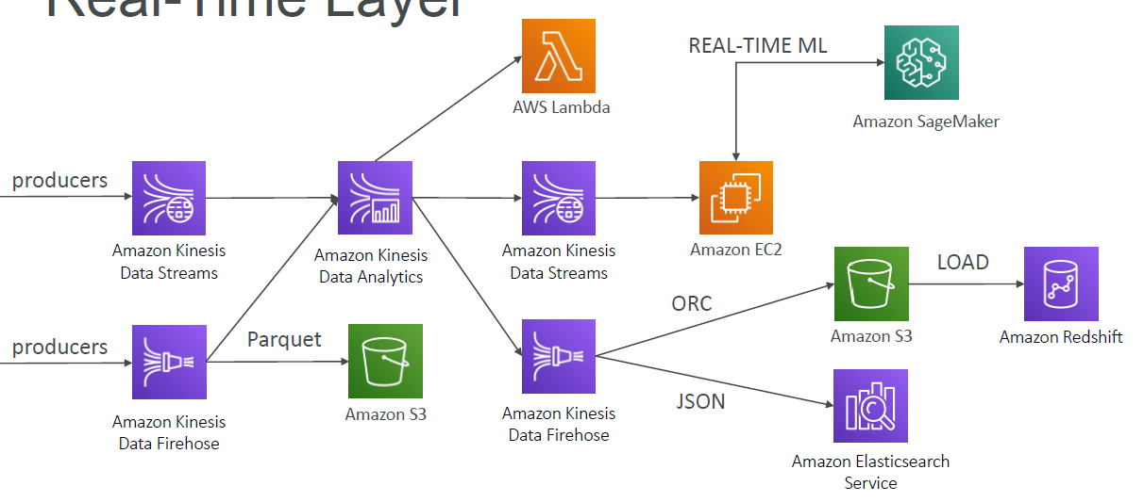
AWS Machine Learning Specialty Course Notes
Data Engineering
Section: 2.25
Date: 18/12/21
Full Data Engineering Pipeline
Real Time Layer

Slide 23
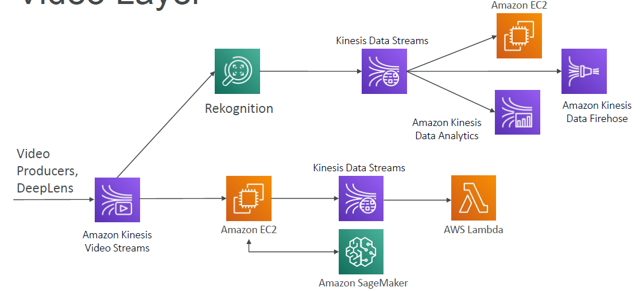
AWS Machine Learning Specialty Course Notes
Data Engineering
Section: 2.25
Date: 18/12/21
Full Data Engineering Pipeline
Video Layer

Slide 24
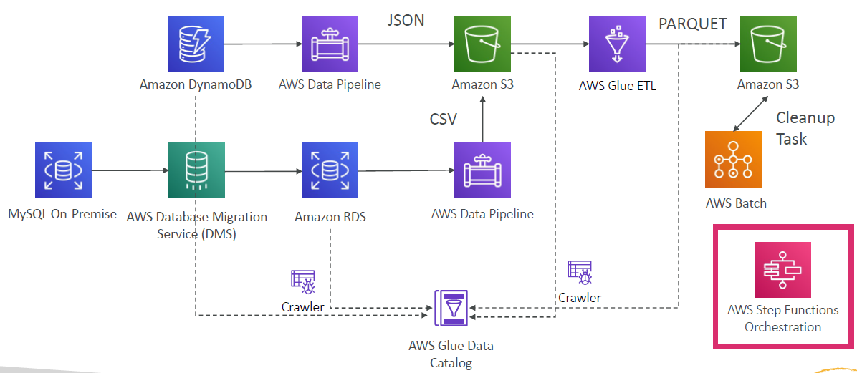
AWS Machine Learning Specialty Course Notes
Data Engineering
Section: 2.25
Date: 18/12/21
Full Data Engineering Pipeline
Batch Layer

Slide 25
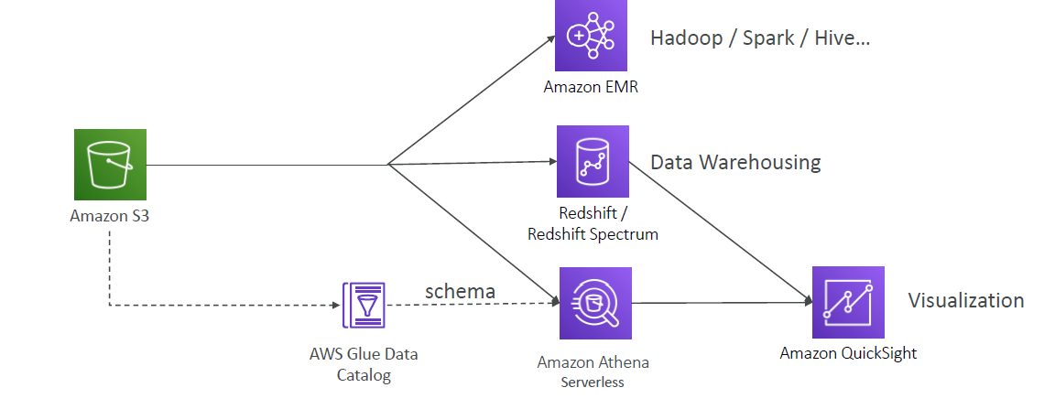
AWS Machine Learning Specialty Course Notes
Data Engineering
Section: 2.25
Date: 18/12/21
Full Data Engineering Pipeline
Analytics Layer

